Slide 1


STORY · CHOICE
COURSE SLIDES · WSQ
Mastering Articulate Storyline 360 for e-Learning Content Creation
Course code TGS-2024042308
TSC Content Strategy · ICT-SNM-4004-1.1
Provider Tertiary Infotech Academy Pte Ltd · UEN: 201200696W
Version v10 · 22 August 2026
© 2026 Tertiary Infotech Academy Pte Ltd · TGS-2024042308

Slide 2
MANDATORY WSQ ADMIN
Digital Attendance
Attendance
Identity
Verification
Complete the trainer-displayed electronic attendance for every required session.
Use only your authorised identity.
Remain until the trainer confirms the record.
Mastering Articulate Storyline 360 for e-Learning Content Creation · TGS-2024042308
2

Slide 3
TRAINER PROFILE
Dr Alfred Ang
Role
Expertise
Facilitation
Principal Trainer · Tertiary Infotech Academy
Digital transformation, courseware, e-learning systems and adult learning.
Concept explanation, coached Storyline practice and evidence review.
Quality
Learning culture
Contact
Traceable storyboards, accessible interactions and verified publishing.
Explain the reason behind every authoring decision.
enquiry@tertiaryinfotech.com · +65 6100 0613
Mastering Articulate Storyline 360 for e-Learning Content Creation · TGS-2024042308
3

Slide 4
OPENING DISCUSSION
Your E-Learning Context
Role
Audience
Channel
What learning or content do you create or manage?
Who must act differently after the experience?
LMS, web, Review 360, video or facilitated delivery?
Friction
Experience
Evidence
Where does current authoring or review lose time?
Which Storyline feature is already familiar?
What artifact will prove improvement?
Mastering Articulate Storyline 360 for e-Learning Content Creation · TGS-2024042308
4

Slide 5
GROUND RULES
Working Agreements
Participate
Respect
Protect assets
Try the tools and explain choices.
Critique the work, not the person.
Use permitted media and retain rights evidence.
Save versions
Share safely
Verify
Preserve BEGIN/END files and name working copies.
Protect learner data and assessment content.
Test preview and published output before delivery.
Mastering Articulate Storyline 360 for e-Learning Content Creation · TGS-2024042308
5

Slide 6
LMS-TMS · LEARNER PACKAGE
Download Course Materials
lms-tms.tertiaryinfotech.com
Mastering Articulate Storyline 360
Courseware · v10
PPTX
PDF
LG
LP
9
Trainer deck
Learner slides
Detailed guide
Delivery plan
Storyline labs
Outcome · the complete package is available in one authenticated course record.
Mastering Articulate Storyline 360 for e-Learning Content Creation · TGS-2024042308
6

Slide 7
COURSE FLOW
Four-Day Learning Journey
1
2
3
4
5
Storyboard
Curate
Interact
Review
Distribute
OUTCOME
The course moves from content intent to accessible Storyline construction, reliable interaction and governed delivery.
Mastering Articulate Storyline 360 for e-Learning Content Creation · TGS-2024042308
7

Slide 8
CONTENT STRATEGY
Skills Framework Alignment
TSC
Course
Duration
Content Strategy · ICT-SNM-4004-1.1
TGS-2024042308
4 days · 32 hours, including 2 hours of assessment
Knowledge
Abilities
Assessment
K1–K6
A1–A7
WA 60 min · PP 60 min
Mastering Articulate Storyline 360 for e-Learning Content Creation · TGS-2024042308
8

Slide 9
K1–K6
Knowledge Criteria
K1
K2
K3
Principles of digital storytelling
Potential customers' evolving preferences for content types, styles and modes of delivery
Process of developing a digital storyboard
K4
K5
K6
Parameters for delivering content for marketing purposes
Features of marketing content
Modes of content delivery for marketing
Mastering Articulate Storyline 360 for e-Learning Content Creation · TGS-2024042308
9

Slide 10
A1–A7
Ability Criteria
A1
A2
Conceptualise content ideas to meet marketing objectives
Map out digital storyboards as part of a content strategy
A3
A4
Identify content requirements from customer and potential-customer preferences
Determine the frequency of delivering marketing content to customers
A5
A6
Determine the types and styles of content to deliver to customers
Determine modes and processes for distributing content
A7
Develop guidelines for content-strategy execution
Mastering Articulate Storyline 360 for e-Learning Content Creation · TGS-2024042308
10

Slide 11
WHAT YOU WILL BE ABLE TO DO
Learning Outcomes
LO1
LO2
Conceptualise and map digital storyboards integrating principles of storytelling in Storyline 360.
Identify and determine diverse e-learning content aligned with audience preferences, industry trends and content features.
LO3
LO4
Determine effective modes and processes for distributing interactive e-learning content.
Develop guidelines and determine content delivery frequency for effective e-learning delivery.
Mastering Articulate Storyline 360 for e-Learning Content Creation · TGS-2024042308
11

Slide 12
FOUR CONNECTED LEARNING UNITS
Course Outline
Topic 1
Topic 2
Get Started on Articulate Storyline 360 Performance gap · story purpose · storyboard · prototype · project model · interface · scenes · slides · layers · quizzes · media libraries LO1 · A1 · A2 · K1 · K3
Working with Assets Visual grammar · pictures · 360° media · video · audio · captions · accessible equivalents · web content · screen recordings · layout LO2 · A3 · A5 · K2 · K5
Topic 3
Topic 4
Interactivity Meaningful choice · learner-controlled discovery · triggers · states · variables · timeline · branching · feedback · motion LO3 · A6 · K6
Presentation, Review and Distribution Themes · masters · player · multi-device UX · accessibility · Review 360 · preview · LMS/LRS publishing · scheduling · governance LO4 · A4 · A7 · K4
Mastering Articulate Storyline 360 for e-Learning Content Creation · TGS-2024042308
12

Slide 13
SUMMATIVE EVIDENCE
Assessment Design
1
2
3
4
5
WA · K1–K6
PP · A1–A2
PP · A3–A5
PP · A6
PP · A4 + A7
OUTCOME
Six written questions and four practical tasks; each instrument is 60 minutes and open book.
Mastering Articulate Storyline 360 for e-Learning Content Creation · TGS-2024042308
13

Slide 14
BEFORE ASSESSMENT
Assessment Briefing
Individual
References
Phones
Complete your own work with no discussion.
Use only materials approved by the assessor.
Place phones and other unapproved materials under the table.
Time
Submission
Outcome
WA 60 min · PP 60 min.
Complete the provided document and upload through LMS-TMS.
Competent or Not Yet Competent, with reassessment and appeal rights.
Mastering Articulate Storyline 360 for e-Learning Content Creation · TGS-2024042308
14

Slide 15
AUTHORING READINESS
Tools, Materials and Workspace
Hardware
Software
Workspace
A supported Windows laptop, suitable display, mouse and reliable storage.
Current supported Articulate Storyline 360 desktop release.
Local working folder with short paths and separate backup.
Sources
Output brief
Safety
Rights-cleared pictures, audio, video, scripts and brand materials.
Audience, device, channel, tracking, accessibility and update requirements.
Versioned .story files, protected assessment content and verified publishes.
Mastering Articulate Storyline 360 for e-Learning Content Creation · TGS-2024042308
15

Slide 16
TOOL CONTEXT
Storyline Scope
Industry use
Windows authoring
Interface drift
Interactive e-learning, simulations, quizzes, scenarios and tracked packages.
Storyline desktop authoring requires a supported Windows environment.
Labels may move as releases evolve; authoring principles remain stable.
Decision over clicks
Responsible AI
Trademark
Choose features by purpose, audience, accessibility and delivery.
Review outputs and retain provenance and permission evidence.
Articulate and Storyline are Articulate trademarks; this course is provider-developed.
Mastering Articulate Storyline 360 for e-Learning Content Creation · TGS-2024042308
16

Slide 17
01
Get Started on Articulate Storyline 360
Performance gap · story purpose · storyboard · prototype · project model · interface · scenes · slides · layers · quizzes · media libraries
LO1 · A1 · A2 · K1 · K3
Mastering Articulate Storyline 360 for e-Learning Content Creation · TGS-2024042308
17

Slide 18
EDITABLE STORYBOARD-PLANNING CHART
Where Authoring Effort Accumulates
READ THE CHART
Illustrative planning split: interactivity is only one workload. Story architecture, media readiness and review evidence must be planned before production.
Editable native PowerPoint chart
Mastering Articulate Storyline 360 for e-Learning Content Creation · TGS-2024042308
Course planning model
18

Slide 19
CONCEPT 01 · HOW IT WORKS
Digital Storytelling as a Learning System
How it works
Best used for
A digital story combines a purposeful narrative, evidence, media and learner agency so attention leads to a decision or behaviour.
Onboarding, compliance, product education and scenario-based learning where context matters.
Professional decision
Quality signal
Choose this method when its learning purpose, audience and runtime behaviour fit the brief.
The narrative can be traced from business objective to learner action and measurable outcome.
Mastering Articulate Storyline 360 for e-Learning Content Creation · TGS-2024042308
Articulate Storyline 360 User Guide
19

Slide 20
KEY CONTROLS · FAILURE MODE · PROOF
Digital Storytelling as a Learning System · control and judgement
CONTROL MAP
WATCH FOR
QUALITY PROOF
Audience; objective; protagonist; tension; choice; consequence; evidence; reflection.
Decorative stories with no decision, irrelevant emotion or a message that conflicts with the learning objective.
The narrative can be traced from business objective to learner action and measurable outcome.
Decision rule · preserve a baseline, test every path, then verify the published experience in its delivery environment.
Mastering Articulate Storyline 360 for e-Learning Content Creation · TGS-2024042308
Articulate Storyline 360 User Guide
20

Slide 21
CONCEPT 02 · HOW IT WORKS
Performance Gap Before Course Design
How it works
Best used for
Course design begins by separating a knowledge or skill gap from process, motivation, tooling or policy problems, then defining the observable performance and measurement strategy.
Deciding whether e-learning is an appropriate response and translating a business need into learner actions.
Professional decision
Quality signal
Choose this method when its learning purpose, audience and runtime behaviour fit the brief.
The brief states the verified gap, the required learner behaviour and how success will be measured.
Mastering Articulate Storyline 360 for e-Learning Content Creation · TGS-2024042308
Articulate ebook: E-Learning for Beginners
21

Slide 22
KEY CONTROLS · FAILURE MODE · PROOF
Performance Gap Before Course Design · control and judgement
CONTROL MAP
WATCH FOR
QUALITY PROOF
Stakeholders; current performance; desired performance; root cause; knowledge/skill evidence; objective; success metric.
Starting with a feature list, accepting one stakeholder's opinion as the whole diagnosis or promising change that training cannot cause.
The brief states the verified gap, the required learner behaviour and how success will be measured.
Decision rule · preserve a baseline, test every path, then verify the published experience in its delivery environment.
Mastering Articulate Storyline 360 for e-Learning Content Creation · TGS-2024042308
Articulate ebook: E-Learning for Beginners
22

Slide 23
CONCEPT 03 · HOW IT WORKS
Storyboard Architecture
How it works
Best used for
A storyboard makes the course visible before production by mapping screens, narration, media, interactions, transitions, branching and evidence.
Stakeholder alignment, estimating effort, accessibility planning and preventing expensive rework.
Professional decision
Quality signal
Choose this method when its learning purpose, audience and runtime behaviour fit the brief.
Every screen has a purpose, every branch reconnects or terminates deliberately, and every asset has an owner.
Mastering Articulate Storyline 360 for e-Learning Content Creation · TGS-2024042308
Articulate Storyline 360 User Guide
23

Slide 24
KEY CONTROLS · FAILURE MODE · PROOF
Storyboard Architecture · control and judgement
CONTROL MAP
WATCH FOR
QUALITY PROOF
Screen ID; purpose; on-screen copy; narration; asset; interaction; branch; accessibility; owner; status.
Treating the storyboard as a static script or failing to show conditional paths and feedback.
Every screen has a purpose, every branch reconnects or terminates deliberately, and every asset has an owner.
Decision rule · preserve a baseline, test every path, then verify the published experience in its delivery environment.
Mastering Articulate Storyline 360 for e-Learning Content Creation · TGS-2024042308
Articulate Storyline 360 User Guide
24

Slide 25
CONCEPT 04 · HOW IT WORKS
Prototype-to-Release Feedback Loop
How it works
Best used for
A small digital prototype makes navigation, visual treatment and interaction tangible before full production; alpha, beta and final releases then narrow the scope of change.
Surfacing hidden requirements, validating risky interactions and controlling stakeholder feedback.
Professional decision
Quality signal
Choose this method when its learning purpose, audience and runtime behaviour fit the brief.
Each review stage has a defined purpose, owner, decision record and traceable source version.
Mastering Articulate Storyline 360 for e-Learning Content Creation · TGS-2024042308
Articulate ebook: E-Learning for Beginners
25

Slide 26
KEY CONTROLS · FAILURE MODE · PROOF
Prototype-to-Release Feedback Loop · control and judgement
CONTROL MAP
WATCH FOR
QUALITY PROOF
Concept approval; prototype scope; review questions; alpha completeness; beta target test; defect threshold; final sign-off.
Building the whole course before testing the live design, mixing preference feedback with defects or making major structural changes during beta.
Each review stage has a defined purpose, owner, decision record and traceable source version.
Decision rule · preserve a baseline, test every path, then verify the published experience in its delivery environment.
Mastering Articulate Storyline 360 for e-Learning Content Creation · TGS-2024042308
Articulate ebook: E-Learning for Beginners
26

Slide 27
CONCEPT 05 · HOW IT WORKS
Audience, Objective and Content Promise
How it works
Best used for
A content promise states what the learner will be able to decide or do and why the experience is worth completing.
Selecting scope, tone, examples and interaction depth for a defined audience.
Professional decision
Quality signal
Choose this method when its learning purpose, audience and runtime behaviour fit the brief.
The opening, activities and assessment all support the same learner promise.
Mastering Articulate Storyline 360 for e-Learning Content Creation · TGS-2024042308
Articulate Storyline 360 User Guide
27

Slide 28
KEY CONTROLS · FAILURE MODE · PROOF
Audience, Objective and Content Promise · control and judgement
CONTROL MAP
WATCH FOR
QUALITY PROOF
Role; prior knowledge; device; context; time; motivation; risk; desired behaviour.
Beginning with software features instead of learner need, or promising outcomes the content cannot support.
The opening, activities and assessment all support the same learner promise.
Decision rule · preserve a baseline, test every path, then verify the published experience in its delivery environment.
Mastering Articulate Storyline 360 for e-Learning Content Creation · TGS-2024042308
Articulate Storyline 360 User Guide
28

Slide 29
CONCEPT 06 · HOW IT WORKS
Project Model and File Discipline
How it works
Best used for
A .story file packages scenes, slides, layers, media, triggers, variables, player settings and project metadata.
Versioned authoring, team handoff, recovery and evidence retention.
Professional decision
Quality signal
Choose this method when its learning purpose, audience and runtime behaviour fit the brief.
The source opens locally, the version is identifiable and a separate backup exists.
Mastering Articulate Storyline 360 for e-Learning Content Creation · TGS-2024042308
Articulate Storyline 360 User Guide
29

Slide 30
KEY CONTROLS · FAILURE MODE · PROOF
Project Model and File Discipline · control and judgement
CONTROL MAP
WATCH FOR
QUALITY PROOF
Local working drive; short path; version name; backup; media links; publish folder; archive.
Authoring directly on a network/removable drive, overwriting the only copy or confusing published output with the source.
The source opens locally, the version is identifiable and a separate backup exists.
Decision rule · preserve a baseline, test every path, then verify the published experience in its delivery environment.
Mastering Articulate Storyline 360 for e-Learning Content Creation · TGS-2024042308
Articulate Storyline 360 User Guide
30

Slide 31
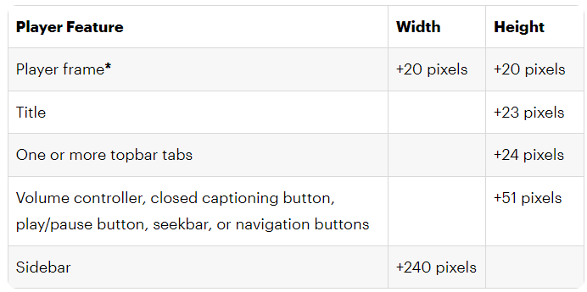
CONCEPT 07 · HOW IT WORKS
Story View, Slide View and Interface
1
How it works
Story View reveals course flow; Slide View reveals one screen's objects, layers, timeline, states, triggers and properties.
2
Best used for
Choosing the right view for architecture versus detailed construction.
3
Professional decision
Choose this method when its learning purpose, audience and runtime behaviour fit the brief.
4
Quality signal
A reviewer can identify scene boundaries, navigation paths and the objects controlling the selected slide.
Mastering Articulate Storyline 360 for e-Learning Content Creation · TGS-2024042308
Articulate Storyline 360 User Guide
31

Slide 32
KEY CONTROLS · FAILURE MODE · PROOF
Story View, Slide View and Interface · control and judgement
CONTROL MAP
WATCH FOR
QUALITY PROOF
Ribbon; scenes; slide canvas; timeline; states; notes; layers; triggers; properties; zoom.
Editing details without checking navigation or interpreting Story View connectors as decorative lines.
A reviewer can identify scene boundaries, navigation paths and the objects controlling the selected slide.
Decision rule · preserve a baseline, test every path, then verify the published experience in its delivery environment.
Mastering Articulate Storyline 360 for e-Learning Content Creation · TGS-2024042308
Articulate Storyline 360 User Guide
32

Slide 33
CONCEPT 08 · HOW IT WORKS
Scenes, Slides and Navigation Order
How it works
Best used for
Scenes group related slides while triggers determine actual navigation, including non-linear branches.
Modules, alternate pathways, remediation and reusable course sections.
Professional decision
Quality signal
Choose this method when its learning purpose, audience and runtime behaviour fit the brief.
Preview proves every intended route, back path and terminal state.
Mastering Articulate Storyline 360 for e-Learning Content Creation · TGS-2024042308
Articulate Storyline 360 User Guide
33

Slide 34
KEY CONTROLS · FAILURE MODE · PROOF
Scenes, Slides and Navigation Order · control and judgement
CONTROL MAP
WATCH FOR
QUALITY PROOF
Scene start; slide order; next/previous triggers; jump target; branching; revisit behaviour.
Assuming visual order equals runtime order or creating branches with no return/exit path.
Preview proves every intended route, back path and terminal state.
Decision rule · preserve a baseline, test every path, then verify the published experience in its delivery environment.
Mastering Articulate Storyline 360 for e-Learning Content Creation · TGS-2024042308
Articulate Storyline 360 User Guide
34

Slide 35
CONCEPT 09 · HOW IT WORKS
Slides, Layers and Revisit Behaviour
How it works
Best used for
A base slide can reveal layers without leaving the slide; layer properties decide visibility, timeline and revisit behaviour.
Progressive disclosure, modal explanations, feedback and controlled exploration.
Professional decision
Quality signal
Choose this method when its learning purpose, audience and runtime behaviour fit the brief.
Layer open/close, focus, timeline and revisit behaviour match the storyboard.
Mastering Articulate Storyline 360 for e-Learning Content Creation · TGS-2024042308
Articulate Storyline 360 User Guide
35

Slide 36
KEY CONTROLS · FAILURE MODE · PROOF
Slides, Layers and Revisit Behaviour · control and judgement
CONTROL MAP
WATCH FOR
QUALITY PROOF
Hide other layers; hide base objects; prevent clicking; pause base; reset/resume/automatic revisit.
Unexpected reset, hidden content exposed to assistive technology or click-through behind a modal layer.
Layer open/close, focus, timeline and revisit behaviour match the storyboard.
Decision rule · preserve a baseline, test every path, then verify the published experience in its delivery environment.
Mastering Articulate Storyline 360 for e-Learning Content Creation · TGS-2024042308
Articulate Storyline 360 User Guide
36

Slide 37
CONCEPT 10 · HOW IT WORKS
Question Slides and Form/Slide Views
How it works
Best used for
Form View defines question data and scoring; Slide View controls the visual and interactive presentation.
Building graded and survey questions while preserving design control.
Professional decision
Quality signal
Choose this method when its learning purpose, audience and runtime behaviour fit the brief.
Preview shows correct scoring, feedback and navigation for correct, incorrect and incomplete responses.
Mastering Articulate Storyline 360 for e-Learning Content Creation · TGS-2024042308
Articulate Storyline 360 User Guide
37

Slide 38
KEY CONTROLS · FAILURE MODE · PROOF
Question Slides and Form/Slide Views · control and judgement
CONTROL MAP
WATCH FOR
QUALITY PROOF
Question type; prompt; choices; correct response; shuffle; attempts; required; score; feedback; branch.
Designing before the scoring model is stable or using a question type that excludes keyboard users.
Preview shows correct scoring, feedback and navigation for correct, incorrect and incomplete responses.
Decision rule · preserve a baseline, test every path, then verify the published experience in its delivery environment.
Mastering Articulate Storyline 360 for e-Learning Content Creation · TGS-2024042308
Articulate Storyline 360 User Guide
38

Slide 39
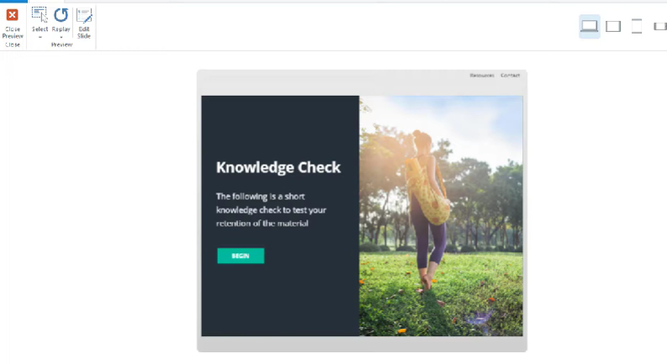
CONCEPT 11 · HOW IT WORKS
Result Slides and Completion Logic
1
How it works
A result slide aggregates selected questions or other result slides and can drive completion, pass/fail and retry logic.
2
Best used for
Quizzes, assessments, knowledge checks and LMS reporting.
3
Professional decision
Choose this method when its learning purpose, audience and runtime behaviour fit the brief.
4
Quality signal
Test attempts prove pass, fail, retry and resume outcomes; reported score matches the visible result.
Mastering Articulate Storyline 360 for e-Learning Content Creation · TGS-2024042308
Articulate Storyline 360 User Guide
39

Slide 40
KEY CONTROLS · FAILURE MODE · PROOF
Result Slides and Completion Logic · control and judgement
CONTROL MAP
WATCH FOR
QUALITY PROOF
Tracked questions; passing score; timer; attempts; submit all; retry; review; completion trigger.
A result slide that tracks the wrong questions or reports completion before required interaction.
Test attempts prove pass, fail, retry and resume outcomes; reported score matches the visible result.
Decision rule · preserve a baseline, test every path, then verify the published experience in its delivery environment.
Mastering Articulate Storyline 360 for e-Learning Content Creation · TGS-2024042308
Articulate Storyline 360 User Guide
40

Slide 41
CONCEPT 12 · HOW IT WORKS
Question Banks, Media Library and Content Library
How it works
Best used for
Question banks randomise reusable questions; Media Library centralises project assets; Content Library supplies reusable templates and media.
Scaling consistent courses, controlled variation and efficient asset updates.
Professional decision
Quality signal
Choose this method when its learning purpose, audience and runtime behaviour fit the brief.
Each draw covers the intended criteria and asset replacement updates all expected instances.
Mastering Articulate Storyline 360 for e-Learning Content Creation · TGS-2024042308
Articulate Storyline 360 User Guide
41

Slide 42
KEY CONTROLS · FAILURE MODE · PROOF
Question Banks, Media Library and Content Library · control and judgement
CONTROL MAP
WATCH FOR
QUALITY PROOF
Bank draw; random count; reuse; replace asset; accessibility metadata; template consistency.
Random draws that miss required coverage or replacing media without checking crops, captions and rights.
Each draw covers the intended criteria and asset replacement updates all expected instances.
Decision rule · preserve a baseline, test every path, then verify the published experience in its delivery environment.
Mastering Articulate Storyline 360 for e-Learning Content Creation · TGS-2024042308
Articulate Storyline 360 User Guide
42

Slide 43
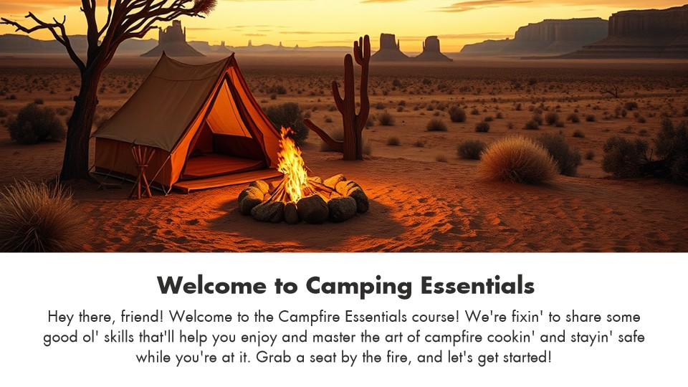
HANDS-ON APPLICATION · TOPIC 1
Lab 01 · Replace Visuals and Establish a Theme
Replace supplied media and harmonise the project theme while preserving scene structure and navigation.
1
2
3
4
5
Analyse
Choose
Apply
Inspect
Evidence
EVIDENCE
Retain the working .story file plus screenshots of Story View, one edited slide and the theme settings.
Creative Minds is adapting a camping orientation template for a new learning campaign and needs a consistent visual identity without rebuilding the course.
Full click-by-click procedure · Learner Guide / Lab 01
Mastering Articulate Storyline 360 for e-Learning Content Creation · TGS-2024042308
43

Slide 44
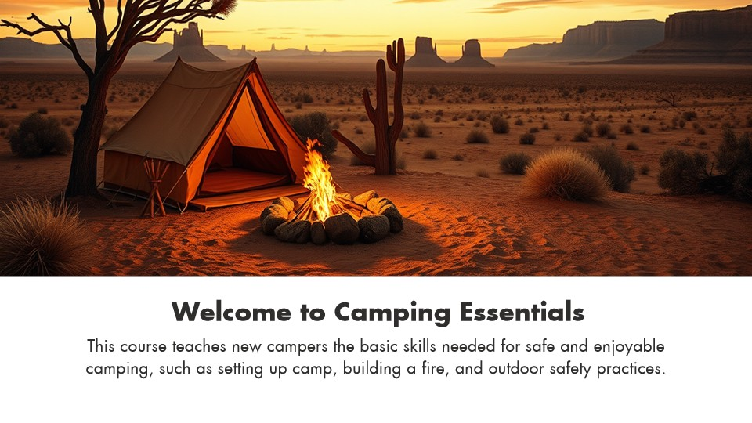
HANDS-ON APPLICATION · TOPIC 1
Lab 02 · Populate the Storyboard with Course Content
Turn a skeletal template into a storyboard-aligned three-slide course overview using reusable project assets.
1
2
3
4
5
Analyse
Choose
Apply
Inspect
Evidence
EVIDENCE
Retain the completed .story file, a three-screen storyboard table and accessibility/focus-order screenshots.
The same camping course now needs meaningful module descriptions and supporting imagery before stakeholder review.
Full click-by-click procedure · Learner Guide / Lab 02
Mastering Articulate Storyline 360 for e-Learning Content Creation · TGS-2024042308
44

Slide 45
EXPLAIN THE DECISION
Topic 1 Checkpoint
Purpose
Audience
Mechanism
What must the learner understand or do?
Which preference or constraint shaped the design?
Which Storyline object or logic implements it?
Failure
Proof
Next
What would make the experience unusable or misleading?
Which preview, publish or accessibility test demonstrates quality?
What evidence would justify the next revision?
Mastering Articulate Storyline 360 for e-Learning Content Creation · TGS-2024042308
45

Slide 46
02
Working with Assets
Visual grammar · pictures · 360° media · video · audio · captions · accessible equivalents · web content · screen recordings · layout
LO2 · A3 · A5 · K2 · K5
Mastering Articulate Storyline 360 for e-Learning Content Creation · TGS-2024042308
46

Slide 47
EDITABLE CONTENT-PLANNING CHART
Accessible Media Mix
READ THE CHART
A mixed design serves different learning needs. Every audio/video element still needs captions, an accessible path and a reason to exist.
Editable native PowerPoint chart
Mastering Articulate Storyline 360 for e-Learning Content Creation · TGS-2024042308
Course design model
47

Slide 48
CONCEPT 13 · HOW IT WORKS
Content Requirements from Audience Preferences
How it works
Best used for
Content type, length, style, interaction and channel are selected from audience evidence rather than author preference.
Microlearning, mobile use, multilingual audiences and role-specific performance support.
Professional decision
Quality signal
Choose this method when its learning purpose, audience and runtime behaviour fit the brief.
A requirements matrix links each preference to a design and delivery response.
Mastering Articulate Storyline 360 for e-Learning Content Creation · TGS-2024042308
Articulate Storyline 360 User Guide
48

Slide 49
KEY CONTROLS · FAILURE MODE · PROOF
Content Requirements from Audience Preferences · control and judgement
CONTROL MAP
WATCH FOR
QUALITY PROOF
Persona; device; bandwidth; accessibility; context; frequency; tone; data sensitivity.
Equating novelty with relevance or using a single format for every audience.
A requirements matrix links each preference to a design and delivery response.
Decision rule · preserve a baseline, test every path, then verify the published experience in its delivery environment.
Mastering Articulate Storyline 360 for e-Learning Content Creation · TGS-2024042308
Articulate Storyline 360 User Guide
49

Slide 50
CONCEPT 14 · HOW IT WORKS
Visual Design Grammar
How it works
Best used for
Colour, contrast, repetition, alignment and balance create hierarchy and unity so learners can recognise what matters and how screens relate.
Establishing a coherent theme, reusable component set and predictable reading path.
Professional decision
Quality signal
Choose this method when its learning purpose, audience and runtime behaviour fit the brief.
A grayscale and alignment review still reveals hierarchy, grouping and intended emphasis across representative screens.
Mastering Articulate Storyline 360 for e-Learning Content Creation · TGS-2024042308
Articulate ebook: Engaging E-Learning
50

Slide 51
KEY CONTROLS · FAILURE MODE · PROOF
Visual Design Grammar · control and judgement
CONTROL MAP
WATCH FOR
QUALITY PROOF
Purposeful palette; strong contrast; repeated typography and shapes; grid alignment; visual weight; consistent image style.
Near-matches that look accidental, too many competing styles, colour-only meaning or balancing decoration instead of instructional emphasis.
A grayscale and alignment review still reveals hierarchy, grouping and intended emphasis across representative screens.
Decision rule · preserve a baseline, test every path, then verify the published experience in its delivery environment.
Mastering Articulate Storyline 360 for e-Learning Content Creation · TGS-2024042308
Articulate ebook: Engaging E-Learning
51

Slide 52
CONCEPT 15 · HOW IT WORKS
Pictures and Visual Hierarchy
How it works
Best used for
Pictures carry meaning when crop, contrast, focal point and proximity support the message.
Context-setting, demonstrations, comparison and emotional framing.
Professional decision
Quality signal
Choose this method when its learning purpose, audience and runtime behaviour fit the brief.
The focal point survives projection and mobile viewing, and the image has appropriate alternative text.
Mastering Articulate Storyline 360 for e-Learning Content Creation · TGS-2024042308
Articulate Storyline 360 User Guide
52

Slide 53
KEY CONTROLS · FAILURE MODE · PROOF
Pictures and Visual Hierarchy · control and judgement
CONTROL MAP
WATCH FOR
QUALITY PROOF
Crop; size; position; transparency; recolour; alt text; compression; replace picture.
Low-resolution sources, decorative clutter, stretched images or text placed over busy detail.
The focal point survives projection and mobile viewing, and the image has appropriate alternative text.
Decision rule · preserve a baseline, test every path, then verify the published experience in its delivery environment.
Mastering Articulate Storyline 360 for e-Learning Content Creation · TGS-2024042308
Articulate Storyline 360 User Guide
53

Slide 54
CONCEPT 16 · HOW IT WORKS
360° Images, Markers and Hotspots
How it works
Best used for
A 360° image creates an explorable environment; markers present information and hotspots define interactive regions.
Virtual tours, safety inspections, product familiarisation and spatial decisions.
Professional decision
Quality signal
Choose this method when its learning purpose, audience and runtime behaviour fit the brief.
Keyboard and pointer tests reach every required target and the learner knows when exploration is complete.
Mastering Articulate Storyline 360 for e-Learning Content Creation · TGS-2024042308
Articulate Storyline 360 User Guide
54

Slide 55
KEY CONTROLS · FAILURE MODE · PROOF
360° Images, Markers and Hotspots · control and judgement
CONTROL MAP
WATCH FOR
QUALITY PROOF
Initial view; marker; hotspot; label; media; navigation; accessibility; completion rule.
Hidden required targets, motion discomfort, inaccessible hotspots or no cue that the scene is interactive.
Keyboard and pointer tests reach every required target and the learner knows when exploration is complete.
Decision rule · preserve a baseline, test every path, then verify the published experience in its delivery environment.
Mastering Articulate Storyline 360 for e-Learning Content Creation · TGS-2024042308
Articulate Storyline 360 User Guide
55

Slide 56
CONCEPT 17 · HOW IT WORKS
Video as Demonstration Evidence
How it works
Best used for
Video shows change over time but requires deliberate pacing, controls, compression and an accessible alternative.
Procedural demonstrations, expert messages and behaviour modelling.
Professional decision
Quality signal
Choose this method when its learning purpose, audience and runtime behaviour fit the brief.
Playback works in the publish target and captions/transcript convey equivalent information.
Mastering Articulate Storyline 360 for e-Learning Content Creation · TGS-2024042308
Articulate Storyline 360 User Guide
56

Slide 57
KEY CONTROLS · FAILURE MODE · PROOF
Video as Demonstration Evidence · control and judgement
CONTROL MAP
WATCH FOR
QUALITY PROOF
Insert/website video; trim; poster frame; playback; controls; captions; transcript; quality.
Autoplay with sound, unreadable screen detail, missing captions or interaction placed over video controls.
Playback works in the publish target and captions/transcript convey equivalent information.
Decision rule · preserve a baseline, test every path, then verify the published experience in its delivery environment.
Mastering Articulate Storyline 360 for e-Learning Content Creation · TGS-2024042308
Articulate Storyline 360 User Guide
57

Slide 58
CONCEPT 18 · HOW IT WORKS
Video and Screencast Production Workflow
How it works
Best used for
Clear audio, a controlled recording environment, a concise outline and a rehearsed screen path improve instructional video more than expensive equipment alone.
Talking-head introductions, software demonstrations and short worked examples.
Professional decision
Quality signal
Choose this method when its learning purpose, audience and runtime behaviour fit the brief.
A test recording is intelligible, visually stable and follows a rehearsed path with no private or distracting content.
Mastering Articulate Storyline 360 for e-Learning Content Creation · TGS-2024042308
Articulate ebook: Great E-Learning Videos
58

Slide 59
KEY CONTROLS · FAILURE MODE · PROOF
Video and Screencast Production Workflow · control and judgement
CONTROL MAP
WATCH FOR
QUALITY PROOF
External microphone; noise/echo check; lighting; stable camera; outline; recording window; prepared files; dry run; edit points.
Relying on camera quality while ignoring sound, improvising a long script, exposing notifications or searching for files during capture.
A test recording is intelligible, visually stable and follows a rehearsed path with no private or distracting content.
Decision rule · preserve a baseline, test every path, then verify the published experience in its delivery environment.
Mastering Articulate Storyline 360 for e-Learning Content Creation · TGS-2024042308
Articulate ebook: Great E-Learning Videos
59

Slide 60
CONCEPT 19 · HOW IT WORKS
Audio, Narration and Closed Captions
How it works
Best used for
Narration can guide attention while captions expose speech and meaningful sound to learners who cannot hear it.
Story-led modules, demonstrations and multilingual or noisy environments.
Professional decision
Quality signal
Choose this method when its learning purpose, audience and runtime behaviour fit the brief.
Audio is intelligible, synchronised and optional; captions are accurate and available in the player.
Mastering Articulate Storyline 360 for e-Learning Content Creation · TGS-2024042308
Articulate Storyline 360 User Guide
60

Slide 61
KEY CONTROLS · FAILURE MODE · PROOF
Audio, Narration and Closed Captions · control and judgement
CONTROL MAP
WATCH FOR
QUALITY PROOF
Record/import; waveform; trim; fade; volume; VTT captions; caption button; transcript.
Narration duplicating every on-screen word, inconsistent levels, timing drift or captions covering controls.
Audio is intelligible, synchronised and optional; captions are accurate and available in the player.
Decision rule · preserve a baseline, test every path, then verify the published experience in its delivery environment.
Mastering Articulate Storyline 360 for e-Learning Content Creation · TGS-2024042308
Articulate Storyline 360 User Guide
61

Slide 62
CONCEPT 20 · HOW IT WORKS
Accessible Media Equivalence
How it works
Best used for
Accessible media provides equivalent meaning through captions, transcripts, descriptive narration or an accessible job aid, while keeping playback under learner control.
Audio, talking-head video, demonstrations and software training used by learners with hearing, vision or mobility limitations.
Professional decision
Quality signal
Choose this method when its learning purpose, audience and runtime behaviour fit the brief.
A learner can obtain the same instructional meaning and complete the task without depending on sight, hearing or precise pointer control.
Mastering Articulate Storyline 360 for e-Learning Content Creation · TGS-2024042308
Articulate ebook: Accessible E-Learning
62

Slide 63
KEY CONTROLS · FAILURE MODE · PROOF
Accessible Media Equivalence · control and judgement
CONTROL MAP
WATCH FOR
QUALITY PROOF
Speaker identification; meaningful sound; visual-action description; transcript; step-based job aid; pause/seek; keyboard path; non-autoplay.
A verbatim transcript that omits visual actions, captions without meaningful sound, forced autoplay or requiring learners to self-identify before receiving an equivalent.
A learner can obtain the same instructional meaning and complete the task without depending on sight, hearing or precise pointer control.
Decision rule · preserve a baseline, test every path, then verify the published experience in its delivery environment.
Mastering Articulate Storyline 360 for e-Learning Content Creation · TGS-2024042308
Articulate ebook: Accessible E-Learning
63

Slide 64
CONCEPT 21 · HOW IT WORKS
Accessibility: Focus, Names and Alternatives
How it works
Best used for
The accessibility tree, focus order, object names and alternative text determine what keyboard and screen-reader users encounter.
Every production course, especially custom navigation and layered interactions.
Professional decision
Quality signal
Choose this method when its learning purpose, audience and runtime behaviour fit the brief.
Keyboard-only and screen-reader walkthroughs preserve meaning, order and operability.
Mastering Articulate Storyline 360 for e-Learning Content Creation · TGS-2024042308
Articulate Storyline 360 Accessibility Maturity Plan
64

Slide 65
KEY CONTROLS · FAILURE MODE · PROOF
Accessibility: Focus, Names and Alternatives · control and judgement
CONTROL MAP
WATCH FOR
QUALITY PROOF
Focus order; visible to accessibility tools; alt text; object name; tab sequence; focus indicator; language.
Decorative objects announced, duplicate labels, illogical focus or interactions that depend only on hover/drag.
Keyboard-only and screen-reader walkthroughs preserve meaning, order and operability.
Decision rule · preserve a baseline, test every path, then verify the published experience in its delivery environment.
Mastering Articulate Storyline 360 for e-Learning Content Creation · TGS-2024042308
Articulate Storyline 360 Accessibility Maturity Plan
65

Slide 66
CONCEPT 22 · HOW IT WORKS
Web Objects and External Content
How it works
Best used for
A web object embeds or launches web content while the course remains responsible for context, security and fallback.
Live reference tools, maps, simulations or approved external services.
Professional decision
Quality signal
Choose this method when its learning purpose, audience and runtime behaviour fit the brief.
Published tests confirm access, fallback, privacy expectations and keyboard exit from the object.
Mastering Articulate Storyline 360 for e-Learning Content Creation · TGS-2024042308
Articulate Storyline 360 User Guide
66

Slide 67
KEY CONTROLS · FAILURE MODE · PROOF
Web Objects and External Content · control and judgement
CONTROL MAP
WATCH FOR
QUALITY PROOF
URL/local web folder; load automatically/on click; display in slide/new window; fallback link; focus.
Third-party tracking, mixed content, offline failure, broken focus or assuming embedded content is accessible.
Published tests confirm access, fallback, privacy expectations and keyboard exit from the object.
Decision rule · preserve a baseline, test every path, then verify the published experience in its delivery environment.
Mastering Articulate Storyline 360 for e-Learning Content Creation · TGS-2024042308
Articulate Storyline 360 User Guide
67

Slide 68
CONCEPT 23 · HOW IT WORKS
Screen Recording Modes
How it works
Best used for
One recording can be inserted as a video or as step-by-step View, Try and Test slides.
Software demonstrations, coached simulations and performance checks.
Professional decision
Quality signal
Choose this method when its learning purpose, audience and runtime behaviour fit the brief.
The learner can see the target action and the simulation accepts the intended interaction.
Mastering Articulate Storyline 360 for e-Learning Content Creation · TGS-2024042308
Articulate Storyline 360 User Guide
68

Slide 69
KEY CONTROLS · FAILURE MODE · PROOF
Screen Recording Modes · control and judgement
CONTROL MAP
WATCH FOR
QUALITY PROOF
Recording area; microphone; screen size; video/View/Try/Test; action captions; mouse path; edits.
Recording personal data, tiny UI, changing software versions or generating unreliable automatic steps.
The learner can see the target action and the simulation accepts the intended interaction.
Decision rule · preserve a baseline, test every path, then verify the published experience in its delivery environment.
Mastering Articulate Storyline 360 for e-Learning Content Creation · TGS-2024042308
Articulate Storyline 360 User Guide
69

Slide 70
CONCEPT 24 · HOW IT WORKS
Shapes, Captions, Text Boxes and Tables
How it works
Best used for
Native objects create editable structure, hierarchy and interactive targets without baking information into an image.
Callouts, process graphics, labels, layouts and accessible data presentation.
Professional decision
Quality signal
Choose this method when its learning purpose, audience and runtime behaviour fit the brief.
Objects remain editable, readable and logically ordered at the delivery size.
Mastering Articulate Storyline 360 for e-Learning Content Creation · TGS-2024042308
Articulate Storyline 360 User Guide
70

Slide 71
KEY CONTROLS · FAILURE MODE · PROOF
Shapes, Captions, Text Boxes and Tables · control and judgement
CONTROL MAP
WATCH FOR
QUALITY PROOF
Fill; line; radius; text style; margins; alignment; table headers; accessibility; states.
Small targets, low contrast, inconsistent typography or using a table only to position content.
Objects remain editable, readable and logically ordered at the delivery size.
Decision rule · preserve a baseline, test every path, then verify the published experience in its delivery environment.
Mastering Articulate Storyline 360 for e-Learning Content Creation · TGS-2024042308
Articulate Storyline 360 User Guide
71

Slide 72
CONCEPT 25 · HOW IT WORKS
Formatting, Sizing and Positioning
How it works
Best used for
Consistent alignment, spacing, size and theme choices reduce cognitive load and make interaction predictable.
Templates, reusable components and multi-author projects.
Professional decision
Quality signal
Choose this method when its learning purpose, audience and runtime behaviour fit the brief.
Shared edges and spacing are consistent; no object clips at common player sizes.
Mastering Articulate Storyline 360 for e-Learning Content Creation · TGS-2024042308
Articulate Storyline 360 User Guide
72

Slide 73
KEY CONTROLS · FAILURE MODE · PROOF
Formatting, Sizing and Positioning · control and judgement
CONTROL MAP
WATCH FOR
QUALITY PROOF
Align; distribute; size; position; rotation; guides; theme fonts/colours; format painter.
Pixel-level drift, stretched media, accidental off-slide objects or inconsistent states.
Shared edges and spacing are consistent; no object clips at common player sizes.
Decision rule · preserve a baseline, test every path, then verify the published experience in its delivery environment.
Mastering Articulate Storyline 360 for e-Learning Content Creation · TGS-2024042308
Articulate Storyline 360 User Guide
73

Slide 74
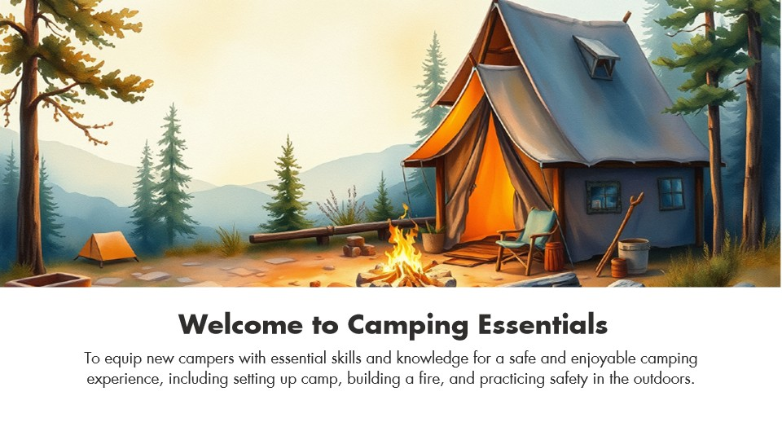
HANDS-ON APPLICATION · TOPIC 2
Lab 03 · Curate and Replace Audience-Fit Media
Evaluate customer preferences, select a suitable visual style and replace project assets consistently.
1
2
3
4
5
Analyse
Choose
Apply
Inspect
Evidence
EVIDENCE
Retain the completed .story file, audience requirements matrix, asset/source register and before/after screenshots.
Stakeholder feedback says the first visual set does not fit new campers in a contemporary learning context.
Full click-by-click procedure · Learner Guide / Lab 03
Mastering Articulate Storyline 360 for e-Learning Content Creation · TGS-2024042308
74

Slide 75
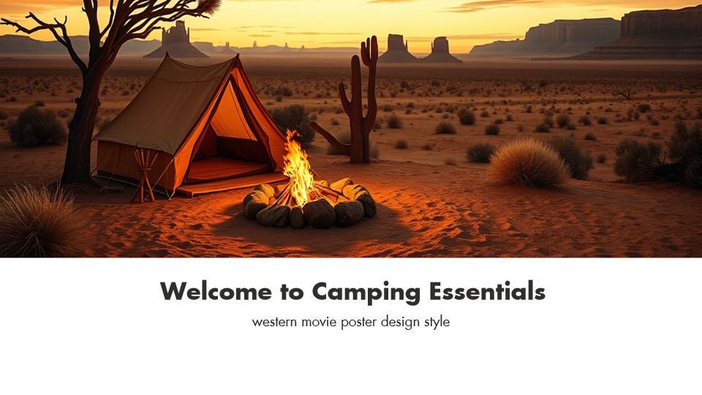
HANDS-ON APPLICATION · TOPIC 2
Lab 04 · Create and Govern an AI-Assisted Visual Variation
Create an AI-assisted visual variation, evaluate it against the brief and retain transparent provenance evidence.
1
2
3
4
5
Analyse
Choose
Apply
Inspect
Evidence
EVIDENCE
Retain the completed .story file, prompt/provenance record, evaluation checklist and before/after screenshots.
Creative Minds wants to test a western-poster visual direction without losing the approved baseline or provenance record.
Full click-by-click procedure · Learner Guide / Lab 04
Mastering Articulate Storyline 360 for e-Learning Content Creation · TGS-2024042308
75

Slide 76
HANDS-ON APPLICATION · TOPIC 2
Lab 05 · Add Narration and Closed Captions
Add and synchronise narration, captions and accessible playback controls without duplicating unnecessary on-screen text.
1
2
3
4
5
Analyse
Choose
Apply
Inspect
Evidence
EVIDENCE
Retain the completed .story file, caption-timing screenshot, waveform/timeline screenshot and accessibility test record.
The course needs optional narration for guidance and accurate captions for learners in noisy or hearing-limited contexts.
Full click-by-click procedure · Learner Guide / Lab 05
Mastering Articulate Storyline 360 for e-Learning Content Creation · TGS-2024042308
76

Slide 77
HANDS-ON APPLICATION · TOPIC 2
Lab 06 · Build a Multi-Slide Audio and Caption System
Implement multiple audio/caption tracks consistently and validate timing, focus and playback behaviour across slides.
1
2
3
4
5
Analyse
Choose
Apply
Inspect
Evidence
EVIDENCE
Retain the completed .story file, media map, scene-wide audio/caption test matrix and representative screenshots.
A three-slide course needs consistent narration, caption files and learner control across the whole scene.
Full click-by-click procedure · Learner Guide / Lab 06
Mastering Articulate Storyline 360 for e-Learning Content Creation · TGS-2024042308
77

Slide 78
EXPLAIN THE DECISION
Topic 2 Checkpoint
Purpose
Audience
Mechanism
What must the learner understand or do?
Which preference or constraint shaped the design?
Which Storyline object or logic implements it?
Failure
Proof
Next
What would make the experience unusable or misleading?
Which preview, publish or accessibility test demonstrates quality?
What evidence would justify the next revision?
Mastering Articulate Storyline 360 for e-Learning Content Creation · TGS-2024042308
78

Slide 79
03
Interactivity
Meaningful choice · learner-controlled discovery · triggers · states · variables · timeline · branching · feedback · motion
LO3 · A6 · K6
Mastering Articulate Storyline 360 for e-Learning Content Creation · TGS-2024042308
79

Slide 80
EDITABLE QA-PLANNING CHART
Interaction Complexity Risk
READ THE CHART
Illustrative test-case counts grow faster than the number of visible screens. Map trigger order, revisit, retry and accessibility before adding complexity.
Editable native PowerPoint chart
Mastering Articulate Storyline 360 for e-Learning Content Creation · TGS-2024042308
Course QA model
80

Slide 81
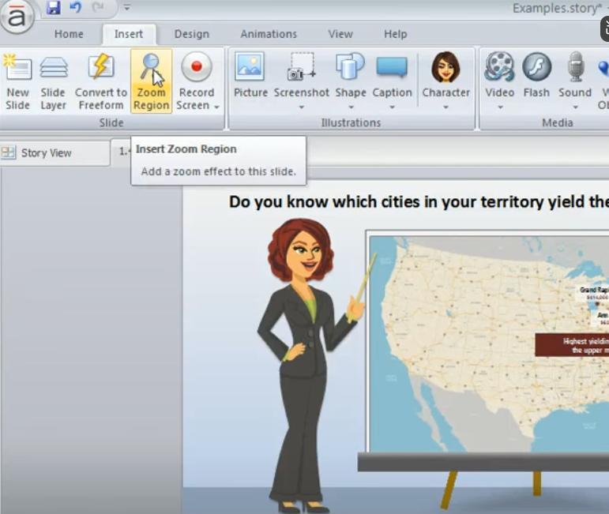
CONCEPT 26 · HOW IT WORKS
Zoom Regions and Guided Attention
1
How it works
A zoom region enlarges a defined area during the slide timeline to direct attention.
2
Best used for
Screen detail, maps and still-image close-ups where context can be restored.
3
Professional decision
Choose this method when its learning purpose, audience and runtime behaviour fit the brief.
4
Quality signal
The zoom begins when the explanation needs it and returns without hiding required context.
Mastering Articulate Storyline 360 for e-Learning Content Creation · TGS-2024042308
Articulate Storyline 360 User Guide
81

Slide 82
KEY CONTROLS · FAILURE MODE · PROOF
Zoom Regions and Guided Attention · control and judgement
CONTROL MAP
WATCH FOR
QUALITY PROOF
Region bounds; position; timeline start/end; speed; layer limitation; return to normal.
Motion without purpose, unreadable destination detail or excessive zoom causing disorientation.
The zoom begins when the explanation needs it and returns without hiding required context.
Decision rule · preserve a baseline, test every path, then verify the published experience in its delivery environment.
Mastering Articulate Storyline 360 for e-Learning Content Creation · TGS-2024042308
Articulate Storyline 360 User Guide
82

Slide 83
CONCEPT 27 · HOW IT WORKS
Buttons, Markers, Hotspots and Controls
How it works
Best used for
Interactive objects expose actions through clear affordances, states, labels and trigger responses.
Exploration, reveal interactions, custom navigation and decision points.
Professional decision
Quality signal
Choose this method when its learning purpose, audience and runtime behaviour fit the brief.
Pointer, keyboard and screen-reader users can identify, operate and understand every control.
Mastering Articulate Storyline 360 for e-Learning Content Creation · TGS-2024042308
Articulate Storyline 360 User Guide
83

Slide 84
KEY CONTROLS · FAILURE MODE · PROOF
Buttons, Markers, Hotspots and Controls · control and judgement
CONTROL MAP
WATCH FOR
QUALITY PROOF
Target size; normal/hover/selected/visited/disabled; alt text; trigger; focus order; feedback.
Invisible hotspots, tiny targets, colour-only state changes or controls that look decorative.
Pointer, keyboard and screen-reader users can identify, operate and understand every control.
Decision rule · preserve a baseline, test every path, then verify the published experience in its delivery environment.
Mastering Articulate Storyline 360 for e-Learning Content Creation · TGS-2024042308
Articulate Storyline 360 User Guide
84

Slide 85
CONCEPT 28 · HOW IT WORKS
Meaningful Choice, Consequence and Feedback
How it works
Best used for
An interaction earns its place when a realistic learner decision changes what happens next and feedback explains the consequence in context.
Scenario practice, judgement calls, objection handling and safe rehearsal of high-risk decisions.
Professional decision
Quality signal
Choose this method when its learning purpose, audience and runtime behaviour fit the brief.
A reviewer can trace each interaction from objective to authentic decision, consequence and transferable feedback.
Mastering Articulate Storyline 360 for e-Learning Content Creation · TGS-2024042308
Articulate ebook: Engaging E-Learning
85

Slide 86
KEY CONTROLS · FAILURE MODE · PROOF
Meaningful Choice, Consequence and Feedback · control and judgement
CONTROL MAP
WATCH FOR
QUALITY PROOF
Relevant prompt; plausible options; decision point; immediate consequence; explanatory feedback; retry/reflection; objective alignment.
Clicking for its own sake, trivia disconnected from work, cosmetic branches or feedback that only says correct/incorrect.
A reviewer can trace each interaction from objective to authentic decision, consequence and transferable feedback.
Decision rule · preserve a baseline, test every path, then verify the published experience in its delivery environment.
Mastering Articulate Storyline 360 for e-Learning Content Creation · TGS-2024042308
Articulate ebook: Engaging E-Learning
86

Slide 87
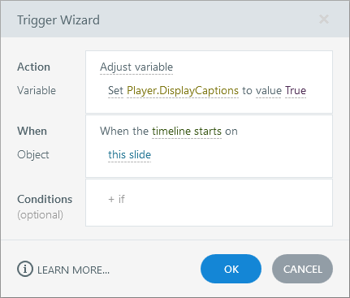
CONCEPT 29 · HOW IT WORKS
Trigger Anatomy and Execution Order
1
How it works
A trigger performs an action on an object or variable when an event occurs, optionally under conditions.
2
Best used for
Navigation, layer control, state changes, media control, scoring and custom logic.
3
Professional decision
Choose this method when its learning purpose, audience and runtime behaviour fit the brief.
4
Quality signal
Trigger panel order matches the logic diagram and tests prove every condition path.
Mastering Articulate Storyline 360 for e-Learning Content Creation · TGS-2024042308
Articulate Storyline 360 User Guide
87

Slide 88
KEY CONTROLS · FAILURE MODE · PROOF
Trigger Anatomy and Execution Order · control and judgement
CONTROL MAP
WATCH FOR
QUALITY PROOF
Action; target; event; object; condition; order; scope; copied trigger.
Correct triggers in the wrong order, triggers attached to covered objects or ambiguous next-slide targets.
Trigger panel order matches the logic diagram and tests prove every condition path.
Decision rule · preserve a baseline, test every path, then verify the published experience in its delivery environment.
Mastering Articulate Storyline 360 for e-Learning Content Creation · TGS-2024042308
Articulate Storyline 360 User Guide
88

Slide 89
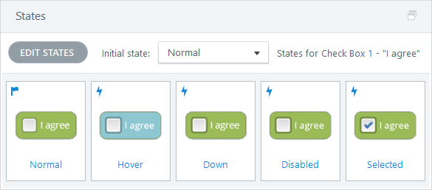
CONCEPT 30 · HOW IT WORKS
Object States
1
How it works
States store visual versions of one object; built-in states may respond automatically while custom states need explicit logic.
2
Best used for
Selection, progress, disabled controls, visited indicators and feedback.
3
Professional decision
Choose this method when its learning purpose, audience and runtime behaviour fit the brief.
4
Quality signal
State changes are predictable, perceivable and preserved appropriately on revisit.
Mastering Articulate Storyline 360 for e-Learning Content Creation · TGS-2024042308
Articulate Storyline 360 User Guide
89

Slide 90
KEY CONTROLS · FAILURE MODE · PROOF
Object States · control and judgement
CONTROL MAP
WATCH FOR
QUALITY PROOF
Normal; hover; down; selected; visited; disabled; custom; initial state; edit states.
Duplicating objects instead of states, hiding critical meaning only in colour or leaving a disabled control focusable.
State changes are predictable, perceivable and preserved appropriately on revisit.
Decision rule · preserve a baseline, test every path, then verify the published experience in its delivery environment.
Mastering Articulate Storyline 360 for e-Learning Content Creation · TGS-2024042308
Articulate Storyline 360 User Guide
90

Slide 91
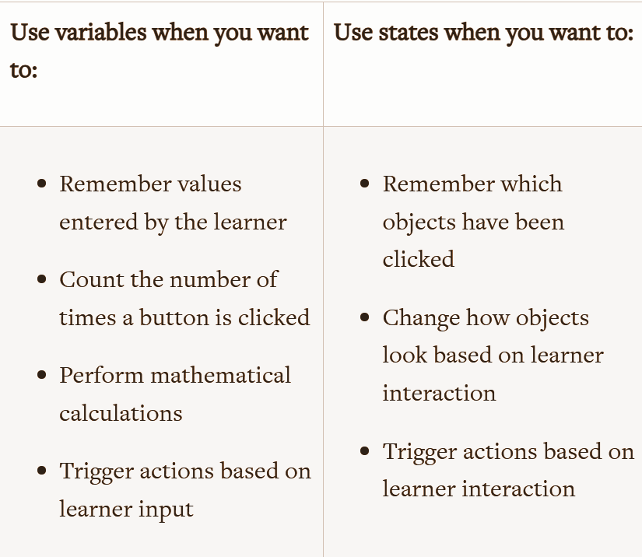
CONCEPT 31 · HOW IT WORKS
Variables and Conditional Logic
1
How it works
Text, number and true/false variables retain information that triggers can evaluate to personalise or control flow.
2
Best used for
Progress gates, scores, names, branching, toggles and completion checks.
3
Professional decision
Choose this method when its learning purpose, audience and runtime behaviour fit the brief.
4
Quality signal
A test matrix proves default, boundary and reset cases and shows the variable value where needed.
Mastering Articulate Storyline 360 for e-Learning Content Creation · TGS-2024042308
Articulate Storyline 360 User Guide
91

Slide 92
KEY CONTROLS · FAILURE MODE · PROOF
Variables and Conditional Logic · control and judgement
CONTROL MAP
WATCH FOR
QUALITY PROOF
Variable type; default; adjust; reference; condition; operator; scope; reset.
Type mismatch, stale values on retry, multiple variables representing one fact or conditions evaluated too early.
A test matrix proves default, boundary and reset cases and shows the variable value where needed.
Decision rule · preserve a baseline, test every path, then verify the published experience in its delivery environment.
Mastering Articulate Storyline 360 for e-Learning Content Creation · TGS-2024042308
Articulate Storyline 360 User Guide
92

Slide 93
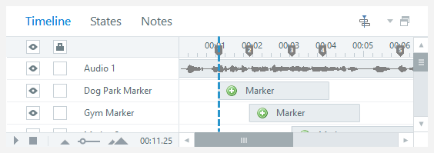
CONCEPT 32 · HOW IT WORKS
Timeline, Cue Points and Synchronisation
1
How it works
The timeline controls when objects and media appear; cue points provide named anchors for synchronised actions.
2
Best used for
Narrated animation, timed reveals and media-coordinated interactions.
3
Professional decision
Choose this method when its learning purpose, audience and runtime behaviour fit the brief.
4
Quality signal
Playback remains synchronised after seeking, replay and common device performance variation.
Mastering Articulate Storyline 360 for e-Learning Content Creation · TGS-2024042308
Articulate Storyline 360 User Guide
93

Slide 94
KEY CONTROLS · FAILURE MODE · PROOF
Timeline, Cue Points and Synchronisation · control and judgement
CONTROL MAP
WATCH FOR
QUALITY PROOF
Start/end; show until end; align to playhead; cue point; lock; visibility; waveform.
Objects ending too early, animation drift after audio edits or a locked timeline hiding the cause.
Playback remains synchronised after seeking, replay and common device performance variation.
Decision rule · preserve a baseline, test every path, then verify the published experience in its delivery environment.
Mastering Articulate Storyline 360 for e-Learning Content Creation · TGS-2024042308
Articulate Storyline 360 User Guide
94

Slide 95
CONCEPT 33 · HOW IT WORKS
Animations, Motion Paths and Transitions
How it works
Best used for
Animations affect objects, motion paths move them, and transitions affect the change between slides.
Demonstrating sequence, change, direction and continuity.
Professional decision
Quality signal
Choose this method when its learning purpose, audience and runtime behaviour fit the brief.
Motion clarifies one teaching point and the static slide still communicates the complete meaning.
Mastering Articulate Storyline 360 for e-Learning Content Creation · TGS-2024042308
Articulate Storyline 360 User Guide
95

Slide 96
KEY CONTROLS · FAILURE MODE · PROOF
Animations, Motion Paths and Transitions · control and judgement
CONTROL MAP
WATCH FOR
QUALITY PROOF
Entrance/exit/emphasis; duration; delay; direction; path; orient to path; transition.
Decorative motion, competing animations, motion-trigger mismatch or inaccessible information shown too briefly.
Motion clarifies one teaching point and the static slide still communicates the complete meaning.
Decision rule · preserve a baseline, test every path, then verify the published experience in its delivery environment.
Mastering Articulate Storyline 360 for e-Learning Content Creation · TGS-2024042308
Articulate Storyline 360 User Guide
96

Slide 97
CONCEPT 34 · HOW IT WORKS
Freeform Interactions and Question Conversion
How it works
Best used for
Existing objects can become selectable, drag-and-drop, text-entry or hotspot responses with scoring and feedback.
Authentic decisions where standard question layouts are too restrictive.
Professional decision
Quality signal
Choose this method when its learning purpose, audience and runtime behaviour fit the brief.
The interaction has an accessible equivalent and correct/incorrect outcomes match the rubric.
Mastering Articulate Storyline 360 for e-Learning Content Creation · TGS-2024042308
Articulate Storyline 360 User Guide
97

Slide 98
KEY CONTROLS · FAILURE MODE · PROOF
Freeform Interactions and Question Conversion · control and judgement
CONTROL MAP
WATCH FOR
QUALITY PROOF
Convert to freeform; response objects; drop targets; correct set; attempts; feedback; accessibility.
Beautiful interaction with ambiguous instructions, overlapping targets or keyboard-inaccessible drag behaviour.
The interaction has an accessible equivalent and correct/incorrect outcomes match the rubric.
Decision rule · preserve a baseline, test every path, then verify the published experience in its delivery environment.
Mastering Articulate Storyline 360 for e-Learning Content Creation · TGS-2024042308
Articulate Storyline 360 User Guide
98

Slide 99
CONCEPT 35 · HOW IT WORKS
Branching Scenarios and Consequences
How it works
Best used for
Branches let learner choices reveal consequences, coaching and alternative routes before reconnecting to a common outcome.
Conversations, safety decisions, customer handling and ethical choices.
Professional decision
Quality signal
Choose this method when its learning purpose, audience and runtime behaviour fit the brief.
Every route has a defined purpose, duration and outcome; the storyboard accounts for all nodes.
Mastering Articulate Storyline 360 for e-Learning Content Creation · TGS-2024042308
Articulate Storyline 360 User Guide
99

Slide 100
KEY CONTROLS · FAILURE MODE · PROOF
Branching Scenarios and Consequences · control and judgement
CONTROL MAP
WATCH FOR
QUALITY PROOF
Decision node; choice; consequence; feedback; variable; branch map; merge point; retry.
Branches that differ only cosmetically, dead ends, exponential complexity or moralising feedback.
Every route has a defined purpose, duration and outcome; the storyboard accounts for all nodes.
Decision rule · preserve a baseline, test every path, then verify the published experience in its delivery environment.
Mastering Articulate Storyline 360 for e-Learning Content Creation · TGS-2024042308
Articulate Storyline 360 User Guide
100

Slide 101
CONCEPT 36 · HOW IT WORKS
Learner-Controlled Pull and Progressive Disclosure
How it works
Best used for
Learners pull concise supporting content when they need it, while essential decisions and objectives remain visible and navigation stays understandable.
Optional examples, definitions, job aids, deeper explanations and non-linear exploration.
Professional decision
Quality signal
Choose this method when its learning purpose, audience and runtime behaviour fit the brief.
The learner can locate needed support, skip known material and still understand what is required for completion.
Mastering Articulate Storyline 360 for e-Learning Content Creation · TGS-2024042308
Articulate ebook: Engaging E-Learning
101

Slide 102
KEY CONTROLS · FAILURE MODE · PROOF
Learner-Controlled Pull and Progressive Disclosure · control and judgement
CONTROL MAP
WATCH FOR
QUALITY PROOF
Need-to-know core; optional layer; label; menu cue; visited state; completion rule; skip path; return point.
Locking every path, hiding required information behind exploration, overwhelming one screen or using unlabeled hotspots.
The learner can locate needed support, skip known material and still understand what is required for completion.
Decision rule · preserve a baseline, test every path, then verify the published experience in its delivery environment.
Mastering Articulate Storyline 360 for e-Learning Content Creation · TGS-2024042308
Articulate ebook: Engaging E-Learning
102

Slide 103
CONCEPT 37 · HOW IT WORKS
Interaction QA and Evidence
How it works
Best used for
Interaction quality is demonstrated with a test matrix covering behaviour, accessibility, content and device conditions.
Before stakeholder review, LMS upload and formal assessment.
Professional decision
Quality signal
Choose this method when its learning purpose, audience and runtime behaviour fit the brief.
A signed checklist records expected versus actual results and links defects to corrected versions.
Mastering Articulate Storyline 360 for e-Learning Content Creation · TGS-2024042308
Articulate Storyline 360 User Guide
103

Slide 104
KEY CONTROLS · FAILURE MODE · PROOF
Interaction QA and Evidence · control and judgement
CONTROL MAP
WATCH FOR
QUALITY PROOF
Happy path; wrong path; boundary; revisit; retry; keyboard; captions; focus; responsive player; resume.
Testing only the author’s preferred path or relying on preview when the publish target behaves differently.
A signed checklist records expected versus actual results and links defects to corrected versions.
Decision rule · preserve a baseline, test every path, then verify the published experience in its delivery environment.
Mastering Articulate Storyline 360 for e-Learning Content Creation · TGS-2024042308
Articulate Storyline 360 User Guide
104

Slide 105
HANDS-ON APPLICATION · TOPIC 3
Lab 07 · Build a Graded Question with Feedback
Add a graded question with plausible distractors, feedback, scoring and accessible response behaviour.
1
2
3
4
5
Analyse
Choose
Apply
Inspect
Evidence
EVIDENCE
Retain the completed .story file, question specification, trigger/feedback screenshots and a five-case test matrix.
The camping module needs a defensible knowledge check on campsite-selection criteria.
Full click-by-click procedure · Learner Guide / Lab 07
Mastering Articulate Storyline 360 for e-Learning Content Creation · TGS-2024042308
105

Slide 106
HANDS-ON APPLICATION · TOPIC 3
Lab 08 · Build a Multi-Question Quiz and Result Logic
Create a multi-question quiz with single- and multiple-response items, feedback, result logic and retry behaviour.
1
2
3
4
5
Analyse
Choose
Apply
Inspect
Evidence
EVIDENCE
Retain the completed .story file, question-to-criterion map, result settings screenshot and pass/fail/retry test log.
The course team must expand the check to cover campsite selection and essential equipment while reporting a reliable result.
Full click-by-click procedure · Learner Guide / Lab 08
Mastering Articulate Storyline 360 for e-Learning Content Creation · TGS-2024042308
106

Slide 107
EXPLAIN THE DECISION
Topic 3 Checkpoint
Purpose
Audience
Mechanism
What must the learner understand or do?
Which preference or constraint shaped the design?
Which Storyline object or logic implements it?
Failure
Proof
Next
What would make the experience unusable or misleading?
Which preview, publish or accessibility test demonstrates quality?
What evidence would justify the next revision?
Mastering Articulate Storyline 360 for e-Learning Content Creation · TGS-2024042308
107

Slide 108
04
Presentation, Review and Distribution
Themes · masters · player · multi-device UX · accessibility · Review 360 · preview · LMS/LRS publishing · scheduling · governance
LO4 · A4 · A7 · K4
Mastering Articulate Storyline 360 for e-Learning Content Creation · TGS-2024042308
108

Slide 109
EDITABLE CHANNEL COMPARISON
Distribution Capability
READ THE CHART
Illustrative 1–5 comparison: choose the channel from interaction, tracking, review and governance requirements—not from export convenience alone.
Editable native PowerPoint chart
Mastering Articulate Storyline 360 for e-Learning Content Creation · TGS-2024042308
Articulate publishing guidance
109

Slide 110
CONCEPT 38 · HOW IT WORKS
Themes, Slide Masters and Design Governance
How it works
Best used for
Themes define fonts and colours while masters/layouts define reusable structure and inheritance.
Brand consistency, accessible templates and efficient multi-course production.
Professional decision
Quality signal
Choose this method when its learning purpose, audience and runtime behaviour fit the brief.
New slides inherit approved typography, contrast and geometry without manual repair.
Mastering Articulate Storyline 360 for e-Learning Content Creation · TGS-2024042308
Articulate Storyline 360 User Guide
110

Slide 111
KEY CONTROLS · FAILURE MODE · PROOF
Themes, Slide Masters and Design Governance · control and judgement
CONTROL MAP
WATCH FOR
QUALITY PROOF
Theme fonts; theme colours; master; layout; placeholder; background; inherited object.
Direct formatting everywhere, editing the wrong level or using master objects as essential interaction targets.
New slides inherit approved typography, contrast and geometry without manual repair.
Decision rule · preserve a baseline, test every path, then verify the published experience in its delivery environment.
Mastering Articulate Storyline 360 for e-Learning Content Creation · TGS-2024042308
Articulate Storyline 360 User Guide
111

Slide 112
CONCEPT 39 · HOW IT WORKS
Player Features and Navigation
How it works
Best used for
The player wraps course content with menu, controls, resources, seekbar, captions and responsive behaviour.
Consistent navigation, learner control and delivery context.
Professional decision
Quality signal
Choose this method when its learning purpose, audience and runtime behaviour fit the brief.
The player supports the storyboard, accessibility plan and completion rules on desktop and mobile.
Mastering Articulate Storyline 360 for e-Learning Content Creation · TGS-2024042308
Articulate Storyline 360 User Guide
112

Slide 113
KEY CONTROLS · FAILURE MODE · PROOF
Player Features and Navigation · control and judgement
CONTROL MAP
WATCH FOR
QUALITY PROOF
Modern/classic player; menu; previous/next; seekbar; volume; captions; resources; labels; resume.
Player controls conflicting with custom navigation, unrestricted seeking bypassing required content or hidden captions.
The player supports the storyboard, accessibility plan and completion rules on desktop and mobile.
Decision rule · preserve a baseline, test every path, then verify the published experience in its delivery environment.
Mastering Articulate Storyline 360 for e-Learning Content Creation · TGS-2024042308
Articulate Storyline 360 User Guide
113

Slide 114
CONCEPT 40 · HOW IT WORKS
Multi-Device UX and Real-Device Testing
How it works
Best used for
Multi-device design combines immediacy, clear affordances and touch-friendly interaction, then verifies the experience in the devices, orientations and contexts learners actually use.
Responsive-player courses, mobile performance support and mixed desktop/tablet/phone audiences.
Professional decision
Quality signal
Choose this method when its learning purpose, audience and runtime behaviour fit the brief.
Desktop, tablet and phone tests record readability, touch accuracy, orientation, media performance, keyboard behaviour and completion/resume results.
Mastering Articulate Storyline 360 for e-Learning Content Creation · TGS-2024042308
Articulate ebook: Multi-Device E-Learning
114

Slide 115
KEY CONTROLS · FAILURE MODE · PROOF
Multi-Device UX and Real-Device Testing · control and judgement
CONTROL MAP
WATCH FOR
QUALITY PROOF
Screen size; orientation; touch target; spacing; hover alternative; readable type; virtual keyboard; gesture cue; bandwidth; real-device matrix.
Shrinking desktop layouts, hiding critical content in hover states, tiny controls, long text entry or trusting a responsive preview as final proof.
Desktop, tablet and phone tests record readability, touch accuracy, orientation, media performance, keyboard behaviour and completion/resume results.
Decision rule · preserve a baseline, test every path, then verify the published experience in its delivery environment.
Mastering Articulate Storyline 360 for e-Learning Content Creation · TGS-2024042308
Articulate ebook: Multi-Device E-Learning
115

Slide 116
CONCEPT 41 · HOW IT WORKS
Accessible Player and Focus Styling
How it works
Best used for
Player accessibility settings affect readable text, focus visibility, keyboard navigation and learner control.
Courses intended for broad public or workforce access.
Professional decision
Quality signal
Choose this method when its learning purpose, audience and runtime behaviour fit the brief.
Published output passes keyboard, zoom, focus and assistive-technology checks.
Mastering Articulate Storyline 360 for e-Learning Content Creation · TGS-2024042308
Articulate Storyline 360 Accessibility Maturity Plan
116

Slide 117
KEY CONTROLS · FAILURE MODE · PROOF
Accessible Player and Focus Styling · control and judgement
CONTROL MAP
WATCH FOR
QUALITY PROOF
Accessible text; focus colour; zoom-to-fit; keyboard shortcuts; labels; captions; playback speed.
Low-contrast focus, disabling navigation shortcuts without an equivalent or assuming authoring preview proves accessibility.
Published output passes keyboard, zoom, focus and assistive-technology checks.
Decision rule · preserve a baseline, test every path, then verify the published experience in its delivery environment.
Mastering Articulate Storyline 360 for e-Learning Content Creation · TGS-2024042308
Articulate Storyline 360 Accessibility Maturity Plan
117

Slide 118
CONCEPT 42 · HOW IT WORKS
Review 360 Collaboration
How it works
Best used for
Review 360 publishes a review copy where stakeholders comment against slides and versions.
Structured review, distributed stakeholders and traceable approval.
Professional decision
Quality signal
Choose this method when its learning purpose, audience and runtime behaviour fit the brief.
Comments have owners and dispositions; the approved version maps to the retained .story source.
Mastering Articulate Storyline 360 for e-Learning Content Creation · TGS-2024042308
Articulate Storyline 360 User Guide
118

Slide 119
KEY CONTROLS · FAILURE MODE · PROOF
Review 360 Collaboration · control and judgement
CONTROL MAP
WATCH FOR
QUALITY PROOF
Publish/update item; reviewer link; password; comments; replies; resolve/reopen; version.
Using comments as the only requirement record, sharing sensitive content broadly or overwriting an approved version.
Comments have owners and dispositions; the approved version maps to the retained .story source.
Decision rule · preserve a baseline, test every path, then verify the published experience in its delivery environment.
Mastering Articulate Storyline 360 for e-Learning Content Creation · TGS-2024042308
Articulate Storyline 360 User Guide
119

Slide 120
CONCEPT 43 · HOW IT WORKS
Preview Strategy and Publish-Only Tests
How it works
Best used for
Preview tests authoring logic quickly, while published output is required for web objects, LMS communication and final runtime behaviour.
Progressive QA from slide to scene to full course and target environment.
Professional decision
Quality signal
Choose this method when its learning purpose, audience and runtime behaviour fit the brief.
The final package is tested in its actual browser/LMS target using the acceptance matrix.
Mastering Articulate Storyline 360 for e-Learning Content Creation · TGS-2024042308
Articulate Storyline 360 User Guide
120

Slide 121
KEY CONTROLS · FAILURE MODE · PROOF
Preview Strategy and Publish-Only Tests · control and judgement
CONTROL MAP
WATCH FOR
QUALITY PROOF
Preview slide/scene/project; replay; device view; publish; browser test; console/LMS test.
Treating preview as final evidence or testing only one browser and screen size.
The final package is tested in its actual browser/LMS target using the acceptance matrix.
Decision rule · preserve a baseline, test every path, then verify the published experience in its delivery environment.
Mastering Articulate Storyline 360 for e-Learning Content Creation · TGS-2024042308
Articulate Storyline 360 User Guide
121

Slide 122
CONCEPT 44 · HOW IT WORKS
Publishing Channels and Trade-offs
How it works
Best used for
Storyline can publish to Review 360, web, video, Word, LMS/LRS and supported distribution platforms; each preserves different capabilities.
Selecting delivery by interactivity, tracking, review, accessibility, connectivity and governance needs.
Professional decision
Quality signal
Choose this method when its learning purpose, audience and runtime behaviour fit the brief.
The chosen channel supports the required interaction, tracking and audience access.
Mastering Articulate Storyline 360 for e-Learning Content Creation · TGS-2024042308
Articulate Storyline 360 User Guide
122

Slide 123
KEY CONTROLS · FAILURE MODE · PROOF
Publishing Channels and Trade-offs · control and judgement
CONTROL MAP
WATCH FOR
QUALITY PROOF
Channel; interactivity; tracking; package; hosting; privacy; update process; offline need.
Publishing interactive content as video, hosting LMS output as plain web content or exposing source files.
The chosen channel supports the required interaction, tracking and audience access.
Decision rule · preserve a baseline, test every path, then verify the published experience in its delivery environment.
Mastering Articulate Storyline 360 for e-Learning Content Creation · TGS-2024042308
Articulate Storyline 360 User Guide
123

Slide 124
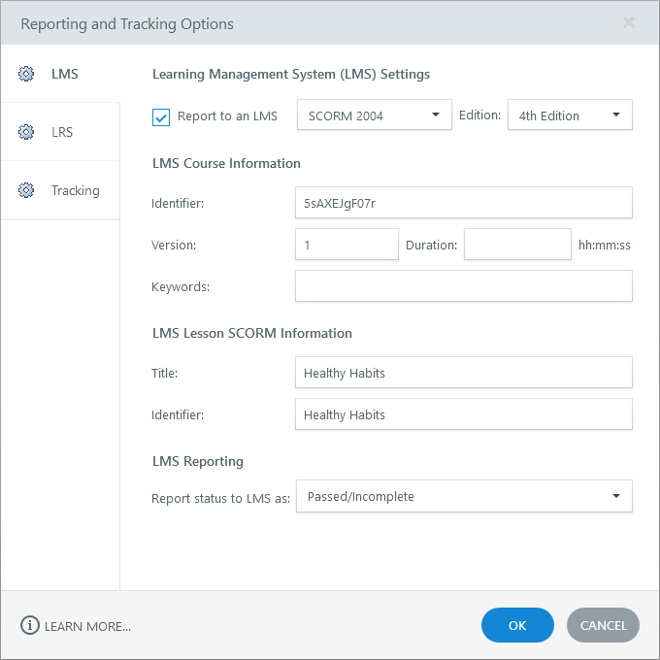
CONCEPT 45 · HOW IT WORKS
LMS/LRS Standards and Tracking
1
How it works
SCORM, AICC, xAPI and cmi5 package content and communicate different completion, score and activity data to a delivery system.
2
Best used for
Tracked learning, compliance evidence and analytics across compatible LMS/LRS platforms.
3
Professional decision
Choose this method when its learning purpose, audience and runtime behaviour fit the brief.
4
Quality signal
A sandbox launch records the intended status, score, completion and resume data.
Mastering Articulate Storyline 360 for e-Learning Content Creation · TGS-2024042308
Articulate Storyline 360 User Guide
124

Slide 125
KEY CONTROLS · FAILURE MODE · PROOF
LMS/LRS Standards and Tracking · control and judgement
CONTROL MAP
WATCH FOR
QUALITY PROOF
Standard/version; completion trigger; result slide; passing score; reporting status; identifier; launch.
Choosing a standard the LMS does not support, changing identifiers carelessly or testing only the launch page.
A sandbox launch records the intended status, score, completion and resume data.
Decision rule · preserve a baseline, test every path, then verify the published experience in its delivery environment.
Mastering Articulate Storyline 360 for e-Learning Content Creation · TGS-2024042308
Articulate Storyline 360 User Guide
125

Slide 126
CONCEPT 46 · HOW IT WORKS
Distribution Plan and Delivery Frequency
How it works
Best used for
A distribution plan maps audience segments to channels, release timing, reminders, maintenance and measurement.
Campaign learning, product launches, onboarding waves and recurring compliance content.
Professional decision
Quality signal
Choose this method when its learning purpose, audience and runtime behaviour fit the brief.
The plan justifies frequency and records owner, success measure and update rule.
Mastering Articulate Storyline 360 for e-Learning Content Creation · TGS-2024042308
Articulate Storyline 360 User Guide
126

Slide 127
KEY CONTROLS · FAILURE MODE · PROOF
Distribution Plan and Delivery Frequency · control and judgement
CONTROL MAP
WATCH FOR
QUALITY PROOF
Audience; channel; cadence; time zone; dependency; owner; metric; refresh trigger; escalation.
Sending too frequently, ignoring local time/context or publishing updates without change communication.
The plan justifies frequency and records owner, success measure and update rule.
Decision rule · preserve a baseline, test every path, then verify the published experience in its delivery environment.
Mastering Articulate Storyline 360 for e-Learning Content Creation · TGS-2024042308
Articulate Storyline 360 User Guide
127

Slide 128
CONCEPT 47 · HOW IT WORKS
Content Strategy Execution Guidelines
How it works
Best used for
Guidelines turn repeated design and publishing decisions into a governed, reviewable operating model.
Multi-author teams and courses that need consistent quality over time.
Professional decision
Quality signal
Choose this method when its learning purpose, audience and runtime behaviour fit the brief.
A new author can build and publish a compliant module using the guideline and checklist.
Mastering Articulate Storyline 360 for e-Learning Content Creation · TGS-2024042308
Articulate Storyline 360 User Guide
128

Slide 129
KEY CONTROLS · FAILURE MODE · PROOF
Content Strategy Execution Guidelines · control and judgement
CONTROL MAP
WATCH FOR
QUALITY PROOF
Voice; brand; accessibility; interaction patterns; naming; review gates; rights; publishing; archive.
A style guide that covers appearance but not behaviour, evidence, ownership or exceptions.
A new author can build and publish a compliant module using the guideline and checklist.
Decision rule · preserve a baseline, test every path, then verify the published experience in its delivery environment.
Mastering Articulate Storyline 360 for e-Learning Content Creation · TGS-2024042308
Articulate Storyline 360 User Guide
129

Slide 130
CONCEPT 48 · HOW IT WORKS
Maintenance, Analytics and Lifecycle
How it works
Best used for
Published learning is monitored, reviewed and retired using learner evidence, defects, content age and business change.
High-use, regulated or frequently changing learning portfolios.
Professional decision
Quality signal
Choose this method when its learning purpose, audience and runtime behaviour fit the brief.
The lifecycle register identifies current version, review trigger, decision and preserved evidence.
Mastering Articulate Storyline 360 for e-Learning Content Creation · TGS-2024042308
Articulate Storyline 360 User Guide
130

Slide 131
KEY CONTROLS · FAILURE MODE · PROOF
Maintenance, Analytics and Lifecycle · control and judgement
CONTROL MAP
WATCH FOR
QUALITY PROOF
Owner; version; review date; analytics; feedback; defect priority; source change; retirement; archive.
No owner, links that outlive the source, silent changes or metrics collected without a decision purpose.
The lifecycle register identifies current version, review trigger, decision and preserved evidence.
Decision rule · preserve a baseline, test every path, then verify the published experience in its delivery environment.
Mastering Articulate Storyline 360 for e-Learning Content Creation · TGS-2024042308
Articulate Storyline 360 User Guide
131

Slide 132
HANDS-ON APPLICATION · TOPIC 4
Lab 09 · Add a Summary, Review and Publish Plan
Create a useful summary slide, define review criteria and configure a publish plan aligned with channel, tracking and delivery frequency.
1
2
3
4
5
Analyse
Choose
Apply
Inspect
Evidence
EVIDENCE
Retain the completed .story file, summary screenshot, QA matrix, Review 360 plan and distribution/frequency decision record.
Creative Minds is preparing the camping course for stakeholder review and a controlled LMS release.
Full click-by-click procedure · Learner Guide / Lab 09
Mastering Articulate Storyline 360 for e-Learning Content Creation · TGS-2024042308
132

Slide 133
EXPLAIN THE DECISION
Topic 4 Checkpoint
Purpose
Audience
Mechanism
What must the learner understand or do?
Which preference or constraint shaped the design?
Which Storyline object or logic implements it?
Failure
Proof
Next
What would make the experience unusable or misleading?
Which preview, publish or accessibility test demonstrates quality?
What evidence would justify the next revision?
Mastering Articulate Storyline 360 for e-Learning Content Creation · TGS-2024042308
133

Slide 134
COURSE SYNTHESIS
Professional Authoring Loop
Brief
Storyboard
Build
Clarify objective, audience, channel and constraints.
Map screens, media, interaction, accessibility and evidence.
Use reusable layouts, named objects and explicit logic.
Test
Review
Deliver
Exercise paths, states, variables, captions, focus and resume.
Record stakeholder comments and dispositions.
Publish, verify, schedule and retain the .story source.
Mastering Articulate Storyline 360 for e-Learning Content Creation · TGS-2024042308
134

Slide 135
CONTENT GOVERNANCE
Copyright and Asset Permission
Ownership
Permission
Scope
Identify the creator or owner.
Public visibility does not grant reuse.
Check modification, commercial and redistribution rights.
People
Attribution
Record
Confirm consent and privacy context.
Credit as the licence requires.
Retain source, licence, consent, date and permitted use.
Mastering Articulate Storyline 360 for e-Learning Content Creation · TGS-2024042308
IPOS copyright resources
135

Slide 136
PROVENANCE AND REVIEW
Responsible Generative AI
Inputs
Log
Review
Use only material you may provide.
Record prompt, source permissions and selected variation.
Check plausibility, bias, accidental text and artefacts.
Terms
Provenance
Responsibility
Confirm current feature and service terms.
Retain generation and edit evidence.
The author owns the publication decision.
Mastering Articulate Storyline 360 for e-Learning Content Creation · TGS-2024042308
136

Slide 137
A7 · EXECUTION CONTROL
Stakeholder Review
Describe
Show
Ask
State purpose, audience and key decisions.
Use Review 360 or approved evidence against the storyboard.
Review against explicit content, interaction and accessibility criteria.
Record
Decide
Revise
Capture owner, comment and due date.
Accept, adapt or reject with reason.
Publish one traceable corrected version.
Mastering Articulate Storyline 360 for e-Learning Content Creation · TGS-2024042308
137

Slide 138
AFTER THE COURSE
Support
Email
Telephone
Portal
enquiry@tertiaryinfotech.com
+65 6100 0613
https://lms-tms.tertiaryinfotech.com/
Provider
Website
Privacy
Tertiary Infotech Academy Pte Ltd
www.tertiarycourses.com.sg
Do not send assessment content publicly.
Mastering Articulate Storyline 360 for e-Learning Content Creation · TGS-2024042308
138

Slide 139
WA + PP
Final Assessment
1
2
3
4
5
Briefing
WA · 60 min
Transition
PP · 60 min
Submit
OUTCOME
Complete your own open-book evidence and upload the provided documents through LMS-TMS when instructed.
Mastering Articulate Storyline 360 for e-Learning Content Creation · TGS-2024042308
139

Slide 140
COMPETENCY SIGN-OFF
Assessment Flow
1
2
3
4
5
Identity check
WA · K1–K6
PP · A1–A7
Assessor decision
Summary sign-off
OUTCOME
Assessment evidence leads to a Competent or Not Yet Competent decision, feedback, reassessment/appeal options and formal sign-off.
Mastering Articulate Storyline 360 for e-Learning Content Creation · TGS-2024042308
140

Slide 141
CLOSING ADMIN
Digital Attendance · Mandatory
Assessment event
Verification
Feedback
Complete the official assessment attendance.
Remain until the trainer verifies the record.
Use the official LMS-TMS/TRAQOM route after attendance.
Mastering Articulate Storyline 360 for e-Learning Content Creation · TGS-2024042308
141

Slide 142
Thank You
Design with intent · build accessibly · verify every path
Mastering Articulate Storyline 360 for e-Learning Content Creation · TGS-2024042308
142

